Slide 1



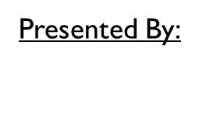
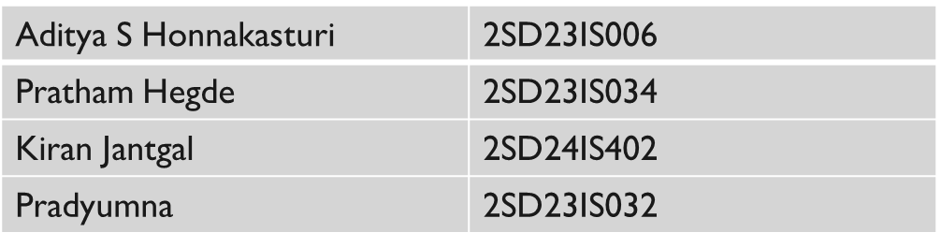
SDM COLLEGE OF ENGINEERING AND TECH DHARWAD
Dept of Information Science And Engineering
Coordinator:
Dr. Varsha Jadhav
Academic year : 2025-26 / V Semester

Slide 2
Introduction
Hostels play a crucial role in managing student accommodation and daily operations
Traditional hostel management relies on manual and fragmented processes
Lack of digital systems leads to inefficiency, delays, and poor coordination
Food wastage in hostel messes is a growing concern due to improper surplus handling
This project proposes a digital platform to streamline hostel operations and promote sustainability

Slide 3
Problem Definition
Manual hostel management processes lead to inefficiency
Delay in complaint resolution and accountability
No real-time room occupancy tracking
Lack of transparency for parents
Significant food wastage in hostel mess

Slide 4
Objectives
Main Objective
To develop a centralized digital platform for efficient hostel management and food surplus distribution
Specific Objective
To digitize hostel operations such as room allocation and complaint management
To improve transparency and communication among students, staff, wardens, and parents
To enable real-time room occupancy tracking
To streamline complaint resolution with proper accountability
To reduce food wastage through structured surplus food redistribution

Slide 5
Existing System
Room Allocation (Manual)
Complaint Register (Paper / Verbal)
No Tracking or Status
Delayed Resolution
Food Surplus Wasted

Slide 6
Proposed System
Digital Room Allocation
Online Complaint System
Real-Time Status Tracking
Faster Resolution
Food Surplus → NGOs

Slide 7
Methodology
Users
Web interface
Backend services
Database
Process flow
User login
Role-based dashboard
Perform action
Backend processing
Database update
Logout

Slide 8
Technologies & Tools Used
React
Frontend Development
Tailwind CSS
UI Styling
Node js / Express js
Backend Development
MangoDB
Data storage & processing
Node Cron Job
Scheduled Tasks Automation
JWT
Authentication & Security
Cloudinary
Image storage
Brevo
Email services
Postman
Testing APIs

Slide 9
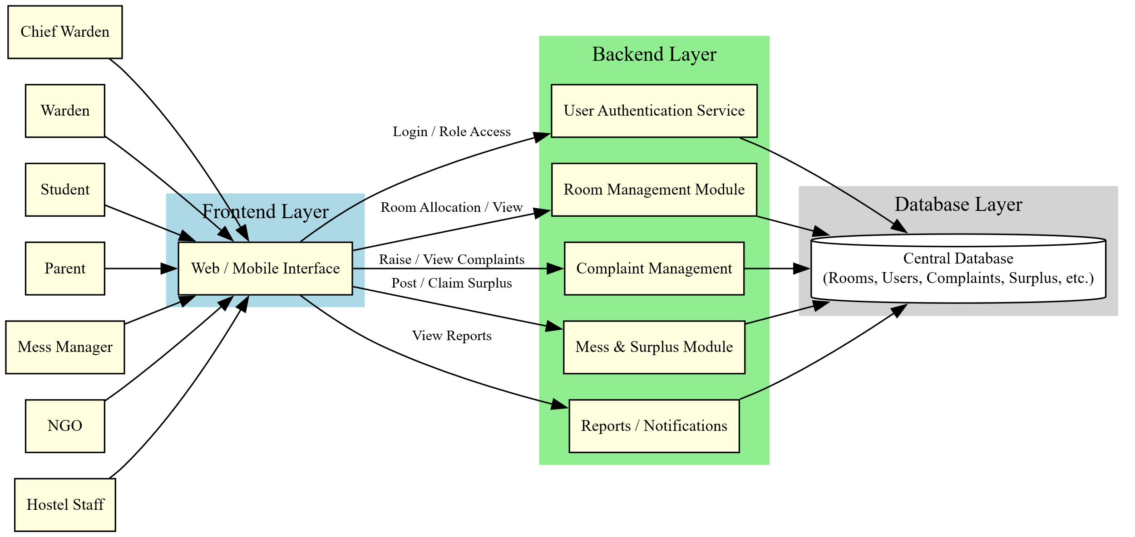
System Design

Slide 10
Implementation
UI / UX
Role-based authentication implemented
Digital room allocation with real-time tracking
Online complaint registration and monitoring
Surplus food posting and NGO coordination
Frontend, backend, and database modules fully integrated for real-time updates
Frontend
Backend
Integration

Slide 11
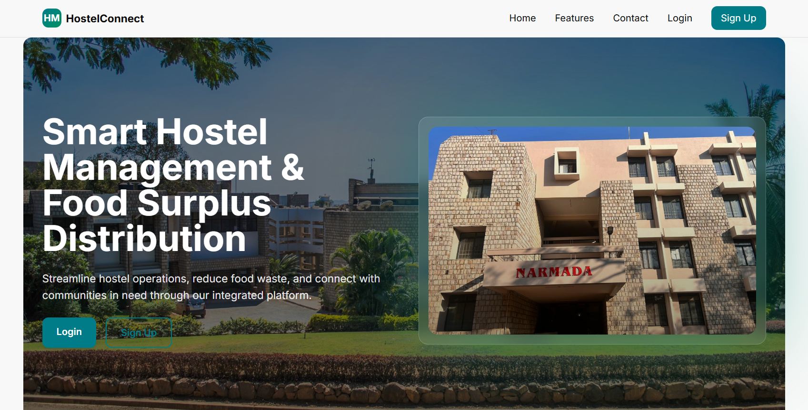
Home page

Slide 12
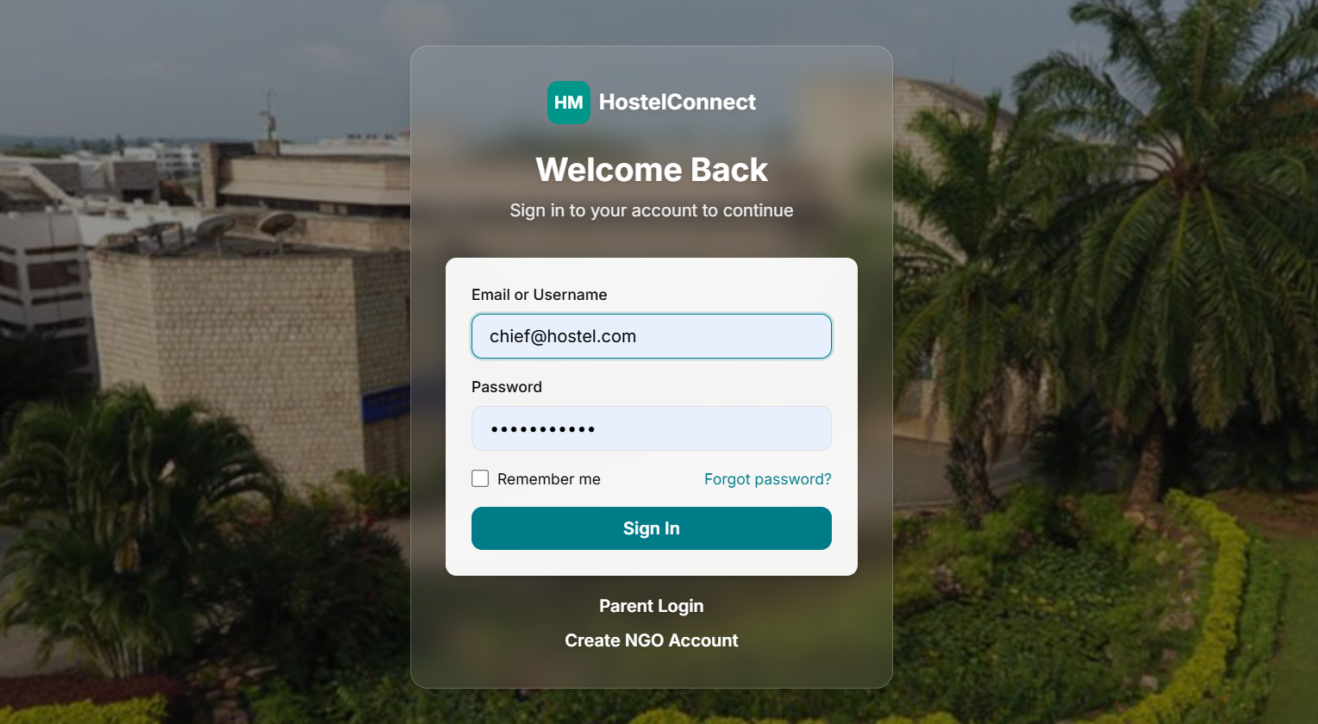
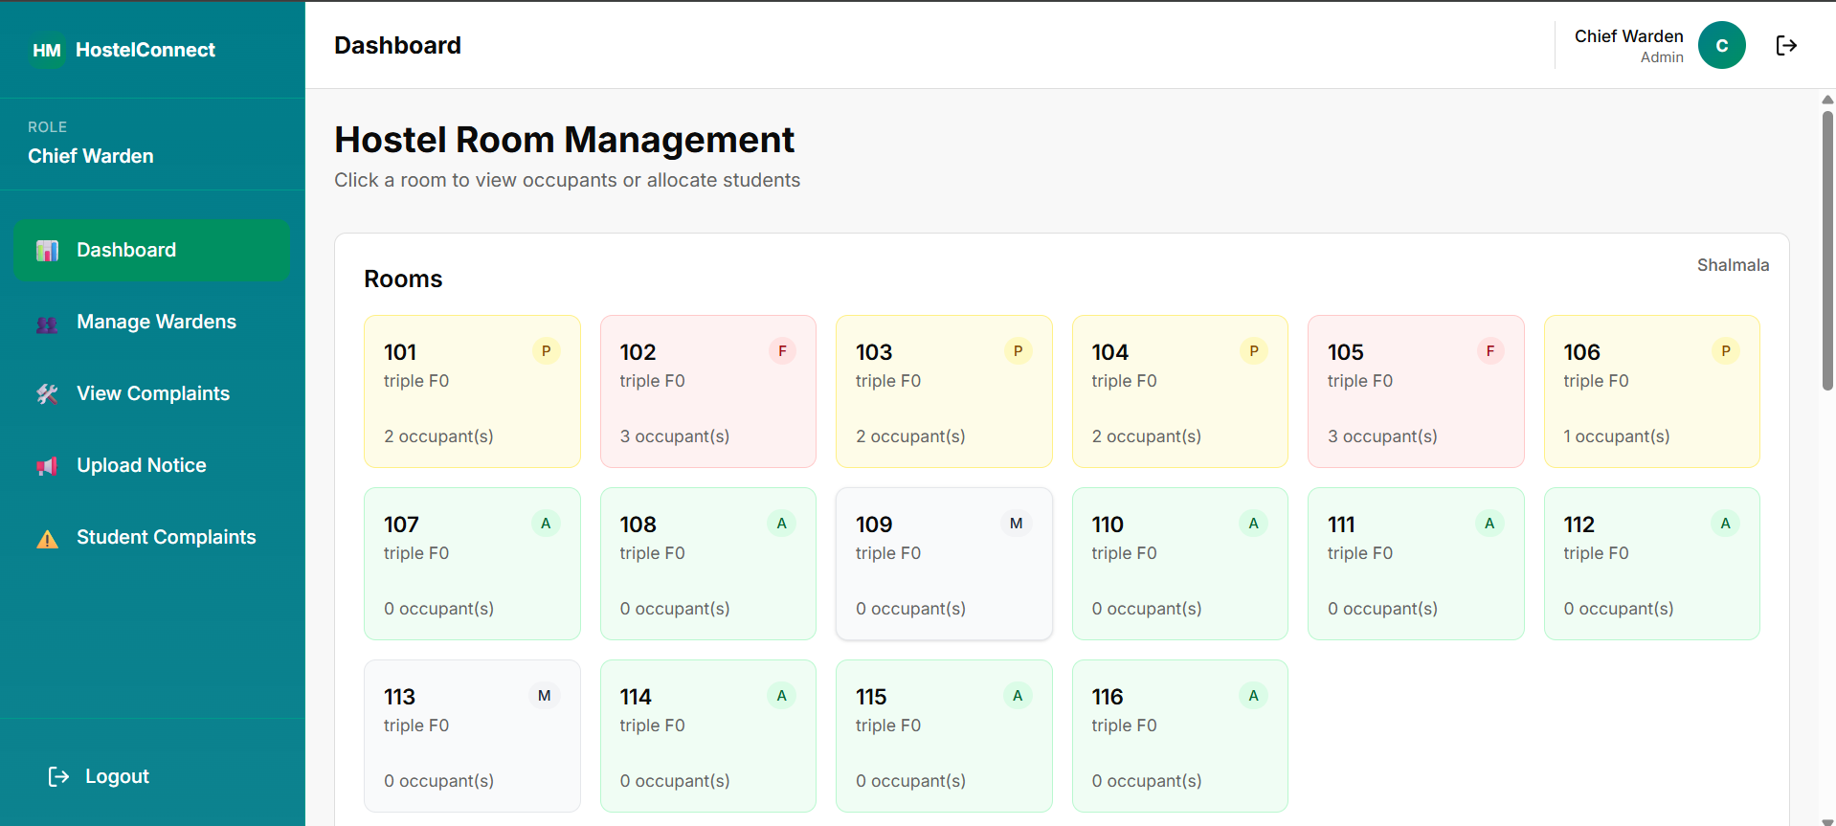
Login page
Chief dashboard

Slide 13
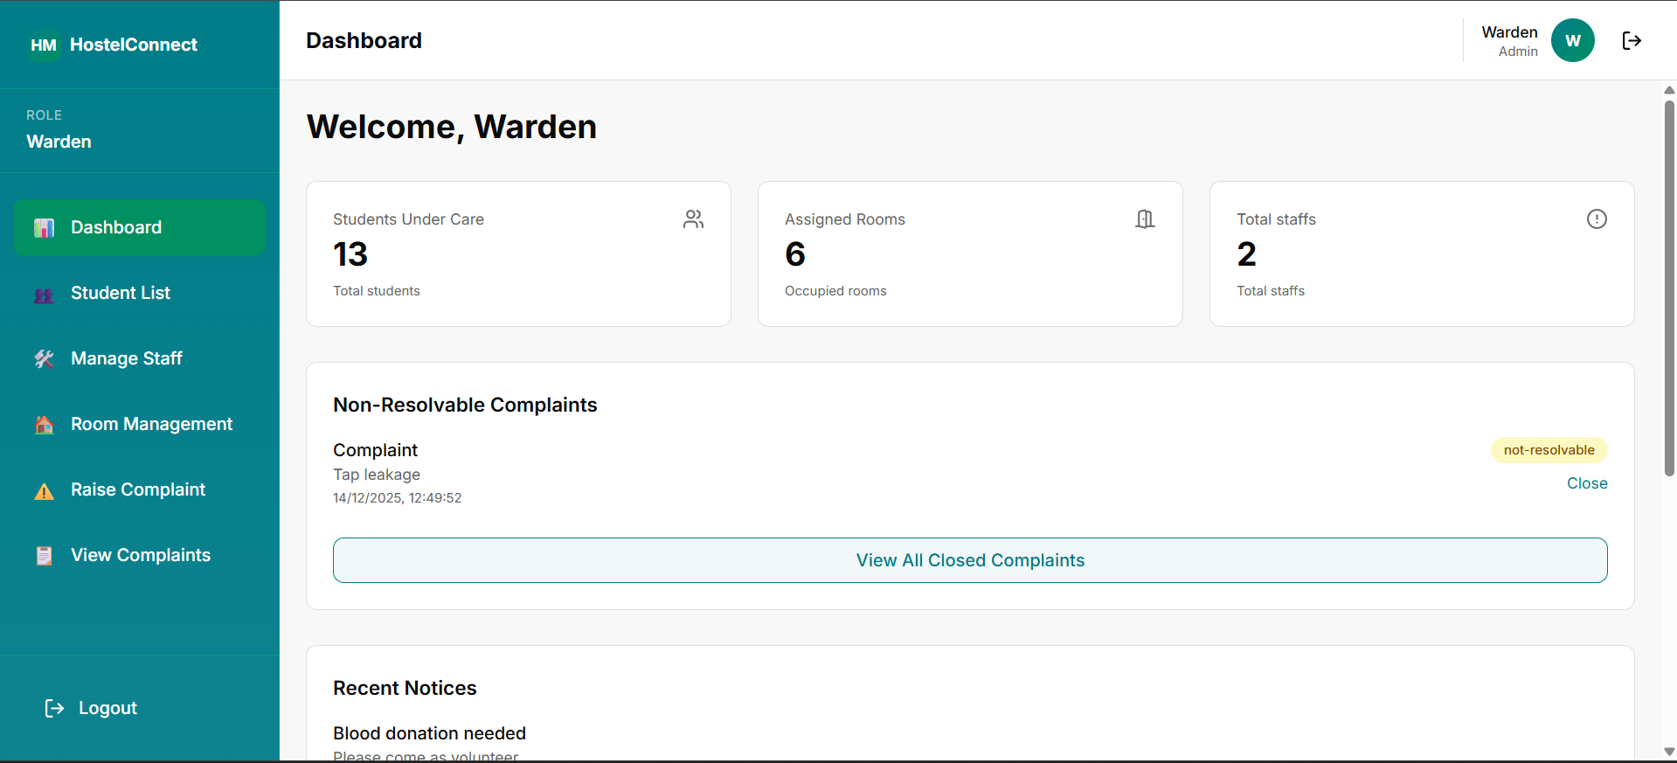
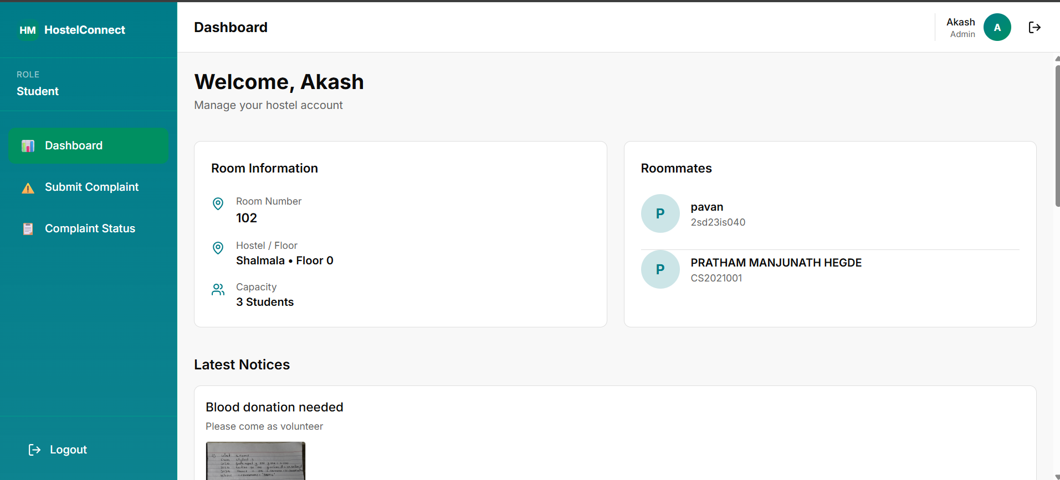
Warden dashboard
Student dashboard

Slide 14
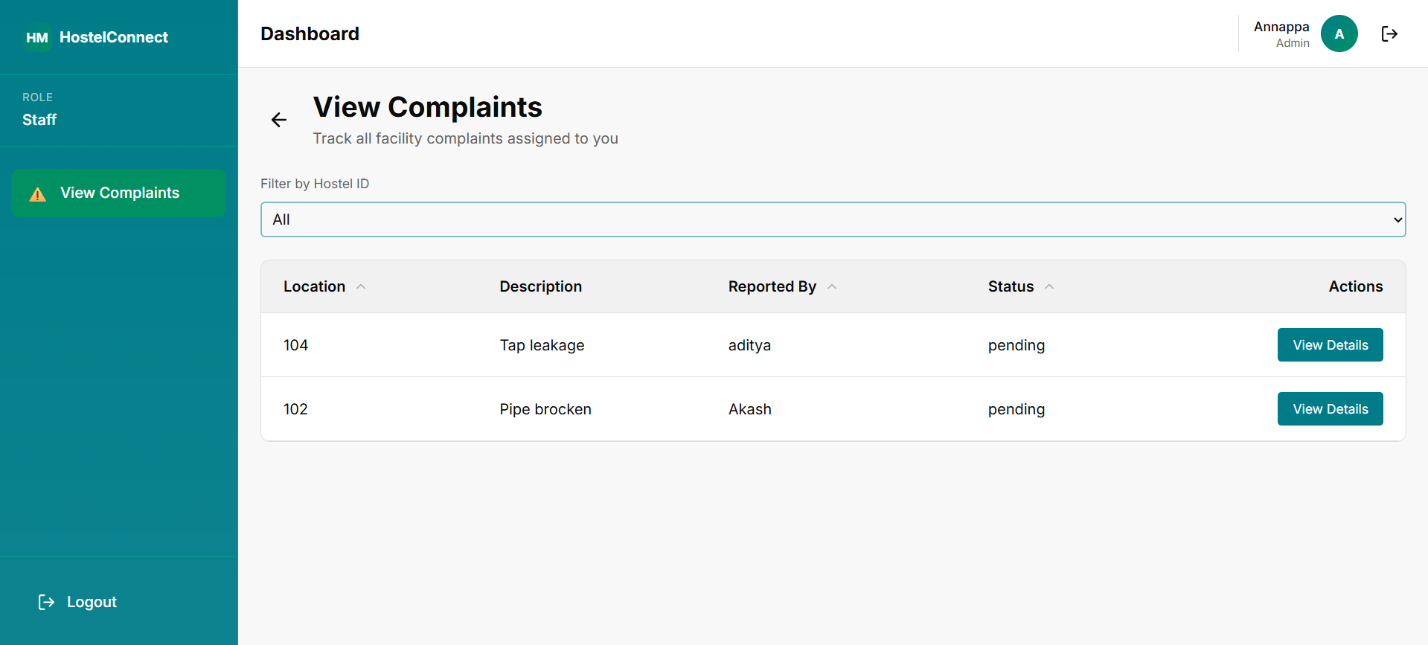
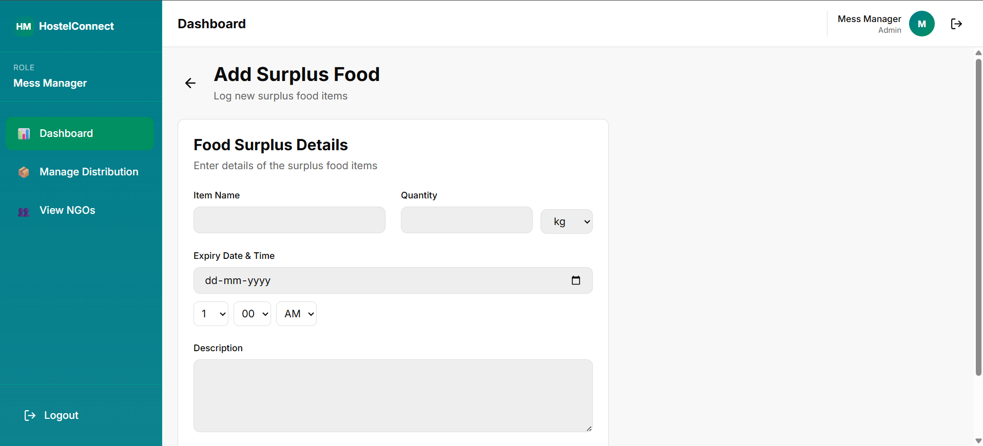
Staff dashboard
Mess manager dashboard

Slide 15
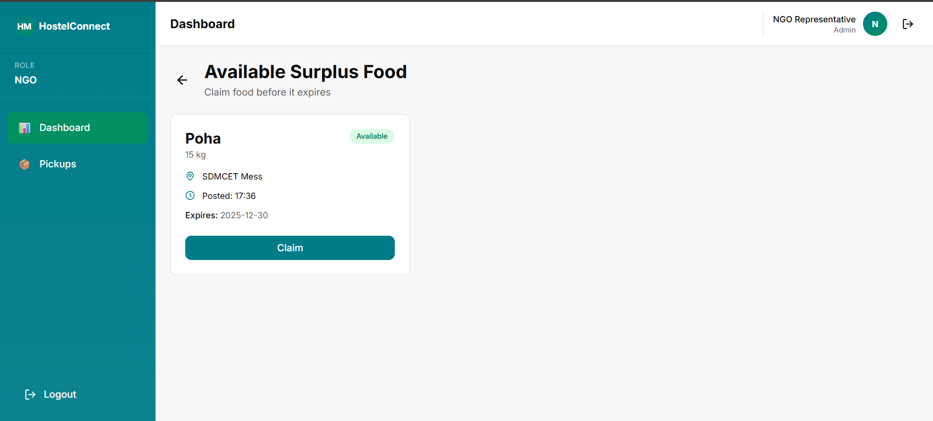
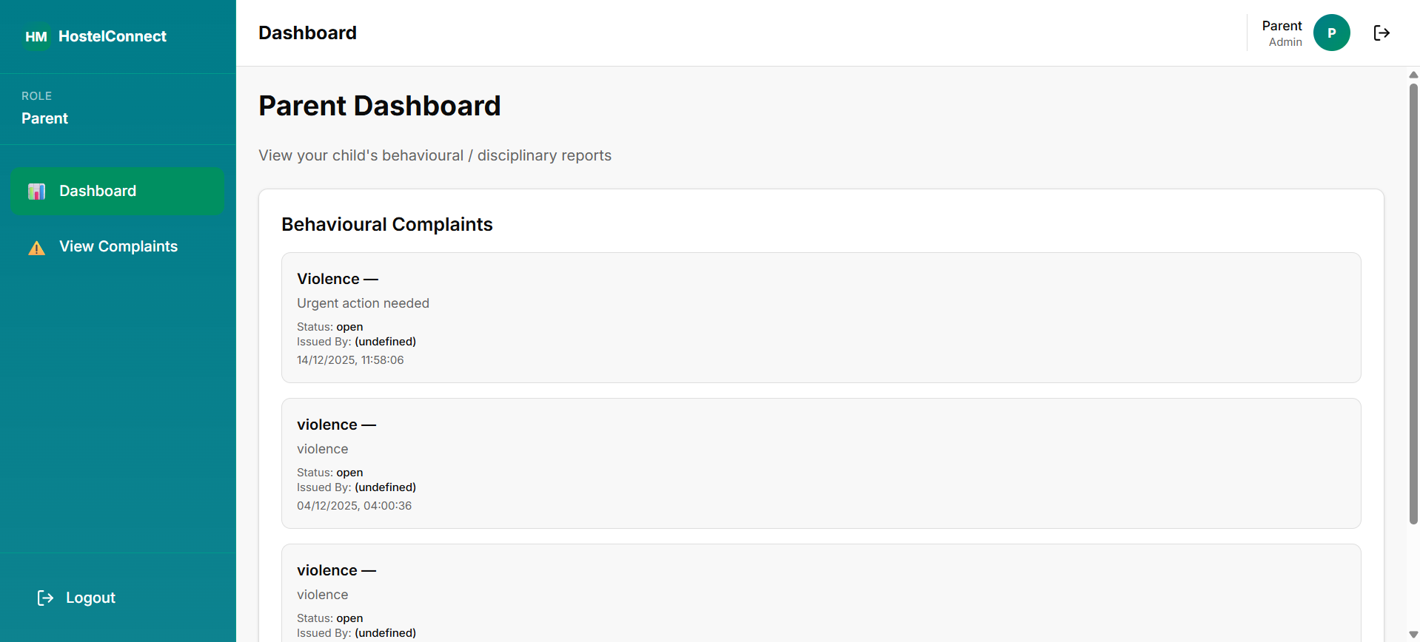
NGO dashboard
Parent dashboard

Slide 16
Results
✔ Faster hostel operations
✔ Real-time room occupancy visibility for authorities
✔ Transparent complaint tracking
✔ Reduced food wastage
✔ Improved parent monitoring

Slide 17
Application & Advantage
Deployment in our college for digital room management, complaints, and parent monitoring
Contribution towards SDG-2 (Zero Hunger) by ensuring edible surplus food reaches the needy
Centralized and role-based system
Reduced food wastage and social impact
Scalable and user-friendly design

Slide 18
Limitation & Conclusion
Limitation
Requires stable internet connectivity for real-time operations
System performance depends on accurate data entry by users
Conclusion
Improves efficiency, transparency, and accountability
Effectively reduces food wastage and supports social responsibility

Slide 19
Thank You

